Slide 1



Opportunity Insights 2023: Unveiling Trends from Archived Data
DATA 603
PROF. HARITHA YANAM
Divya Sai Balaji (ZM13779)
Poornima Kolasani (AL79610)

Slide 2
INTRODUCTION TO DATASET
The System for Award Management (SAM.gov) is an official website of the U.S. Government. The General Services Administration operates the System for Award Management (SAM) which posts contract opportunities and procurement notices from Federal contracting offices. Anyone interested in doing business with the government can use this system to search for opportunities. Opportunities include pre-solicitation notices, solicitation notices, award notices, and sole source notices. This website provides contract data reports provide detailed information on awarded contracts using data directly from the Federal Data Procurement System(FPDS).
https://sam.gov/data-services/Contract%20Opportunities/Archived%20Data?privacy=Public

Slide 3
The SAM.gov can be used for the following purposes:
Register to do business with the U.S. Government and Update, renew, or check the status of your entity registration.
Search for entity registration and exclusion records.
View and submit Bio Preferred and Service Contract Reports.
Access publicly available award data via data extracts and system accounts.
Under the SAM.gov, we have used the dataset related to the Contract opportunities. (FY-2023)
Contract opportunities are listings of federal business opportunities greater than $25,000, including synopses of proposed contract actions, solicitations, and associated information that can be accessed electronically by the public. Organizations registered in SAM.gov may compete to be awarded federal
contracts.

Slide 4
FEATURES OF THE DATASET
The Dataset consists of 372712 rows and 47 columns.
The Dataset is in CSV Format.
The Columns include: Notice Id, TitleSol#, Department/Ind.Agency, CGAC, Sub-Tier, FPDS Code, Office, AAC Code,PostedDate,Type,BaseType,ArchiveType,ArchiveDate,SetASideCode,SetASide,ResponseDeadLine,NaicsCode,ClassificationCode,PopStreetAddress,PopCity,PopState,PopZip,PopCountry,Active,AwardNumber,AwardDate,Award$,Awardee,PrimaryContactTitle,PrimaryContactFullname,PrimaryContactEmail,PrimaryContactPhone,PrimaryContactFax,SecondaryContactTitle,SecondaryContactFullname,SecondaryContactEmail,SecondaryContactPhone,SecondaryContactFax,OrganizationType,State,City,ZipCode,CountryCode,AdditionalInfoLink,Link,Description

Slide 5
PROBLEM STATEMENT
Analyzing trends over time in the issuance of opportunities, focusing on variables like department, type, and geographical distribution.
Departmental Spending Analysis: Leverage the financial columns (like Award$, AwardDate) to analyze spending patterns across different departments or agencies. Spark's ability to handle large datasets can be utilized to process and aggregate financial data to uncover insights into spending trends or anomalies.
Geographical Analysis of Awards: Use location-based data (PopCity, PopState, CountryCode) to perform a geographical analysis of where awards are being distributed. This can involve mapping the data and using Spark's capabilities to handle geospatial data for insights into regional disparities or concentrations.
Predictive Modeling for Award Amounts: Use the historical data to build predictive models for future award amounts (Award$). This could involve using Spark's machine learning libraries to predict the size of awards based on factors like department, NAICS code, and location. give detailed pyspark code

Slide 6
ANALYSIS METHODS
The analysis typically involves processing and analyzing large volumes of data to identify patterns, trends, and preferences of users. The data includes information such as Notice Id, TitleSol#, Department/Ind.Agency, CGAC, Sub-Tier, FPDS Code, Office, AAC Code, PostedDate, Type, BaseType, ArchiveType, ArchiveDate etc.
Programming languages like Python and libraries for data manipulation, analysis, and visualizations like pyspark, pandas, NumPy, seaborn, folium, and matplotlib are frequently utilized tools for data analysis.
In the context of our Contract opportunities analysis we have used methods like data processing, data cleaning, data visualization and we have also used machine learning algorithms like Random forest, logistic regression and Decision trees.

Slide 7
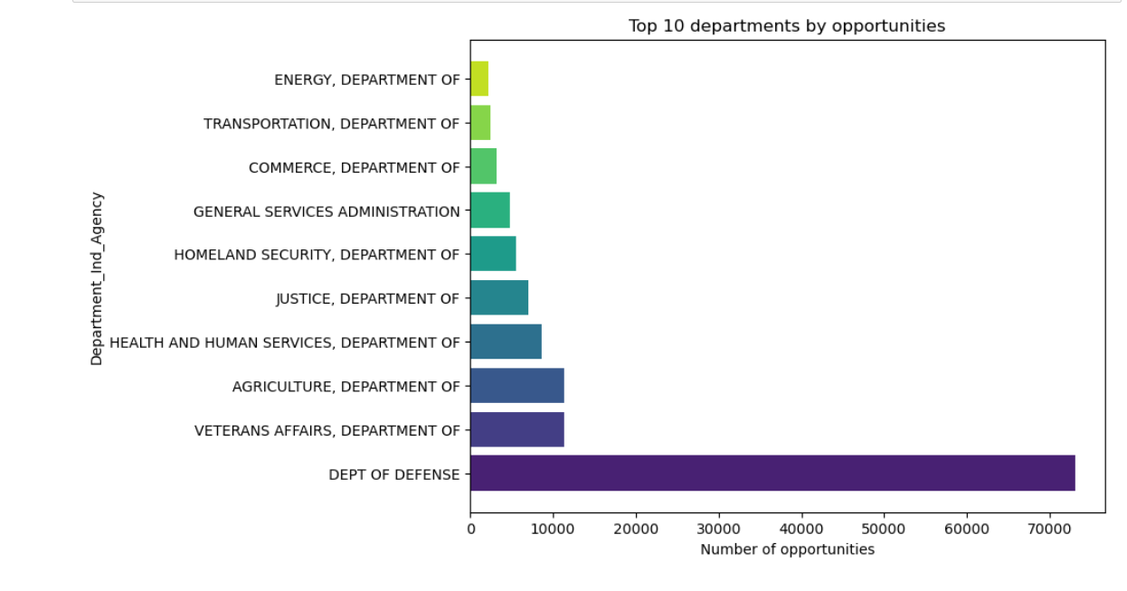
RESULTS AND VISUALS
PROBLEM STATEMENT 1.
Plot representing top 10 departments sorted with respect to opportunities count. It can be seen that Department of Defense has the highest no. of opportunities.

Slide 8
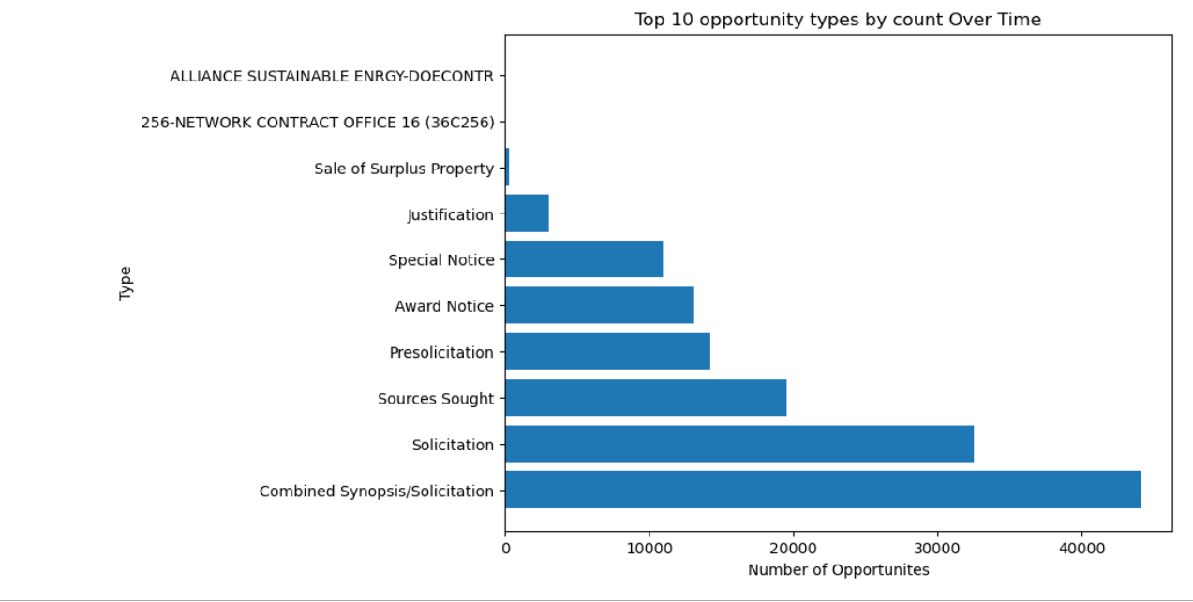
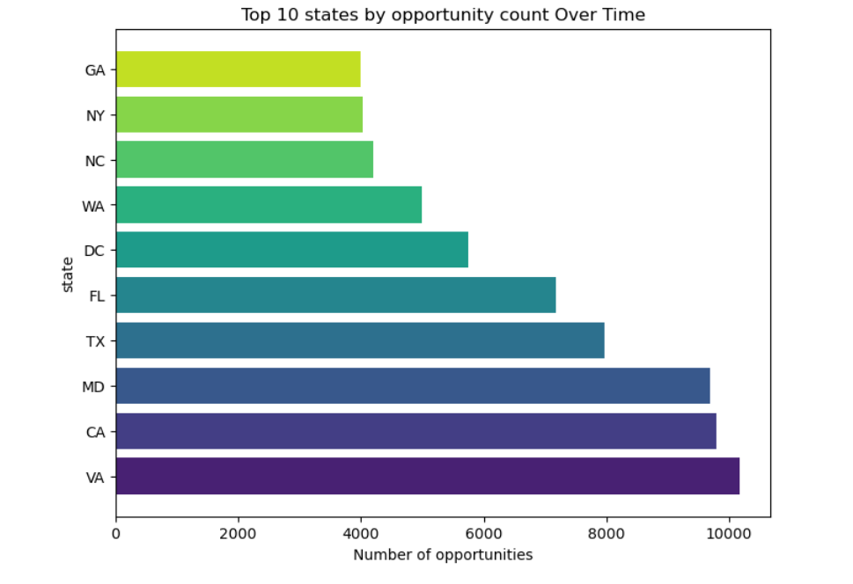
Plot representing top 10 Types of opportunities sorted with respect to opportunities count. It can be seen that Combined Synopsis/Solicitation has the highest no.of opportunities.
Plot representing the count of opportunities by state. It can be seen that Virginia has the highest no.of opportunities.

Slide 9
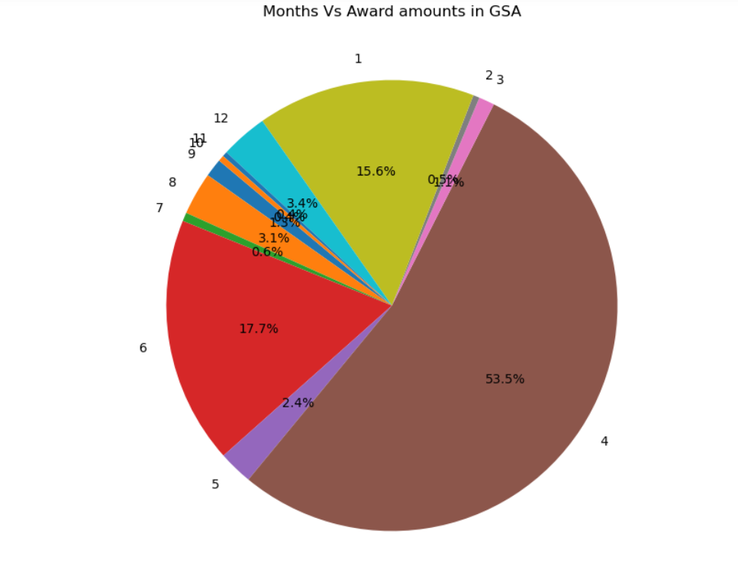
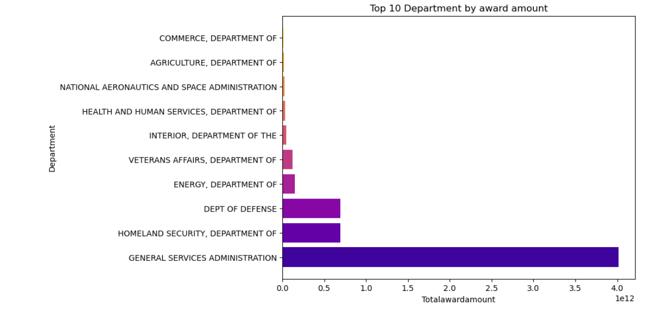
PROBLEM STATEMENT 2.
Plot representing the different departments sorted according to their award amounts. It can be seen that General services Administration has the highest total award amount.
As observed in the previous plot we can see the general services administration has the highest award amount so we considered the general service administration department and depicted the highest award amount for each month in that particular department. we can see that April has the highest award amount recorded.

Slide 10
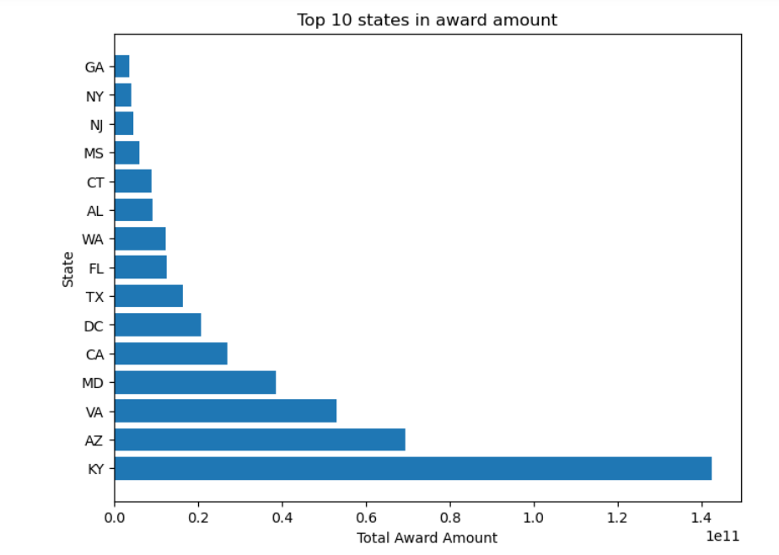
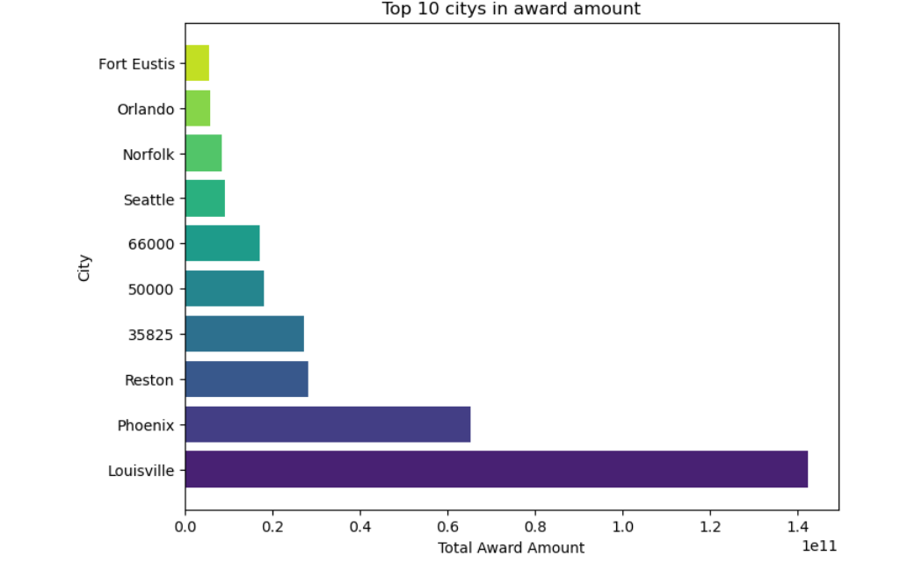
PROBLEM STATEMENT 3.
Above plot represents top 10 states sorted with respect to award amounts and it can be seen that Kentucky has the highest award amount.
plot represents different cities sorted in order of total award amount. It can be seen that Louisville has the highest award amount.

Slide 11

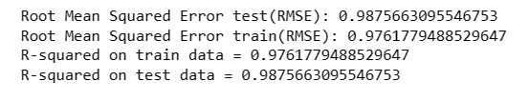

PROBLEM STATEMENT 4.
LINEAR REGRESSION: Linear regression is a statistical method used to model the relationship between a dependent variable and one or more independent variables by fitting a linear equation to observed data.
DECISION TREES: A decision tree is a predictive modeling tool used in machine learning and data analysis. It represents a flowchart-like structure where each internal node represents a decision based on the value of a specific feature, leading to subsequent nodes or leaves representing outcomes or further decisions.
RANDOM FOREST REGRESSOR: A Random Forest Regressor is an ensemble machine learning algorithm used for regression tasks. It operates by constructing multiple decision trees during training and outputs the average prediction of the individual trees for regression problems.

Slide 12
FUTURE SCOPE
Time Series Analysis: If the data involves temporal information, explore time series analysis to understand and forecast trends over time.
Integration with External Data: Combine the dataset with external sources to enrich the information and provide a broader context.
Dashboard and Reporting: Develop interactive dashboards or reports to communicate findings to stakeholders.
Business Intelligence: Apply business intelligence techniques to derive actionable insights for decision-making.
Pattern Recognition: Use advanced techniques like clustering or anomaly detection to identify patterns in the data.

Slide 13
THANK YOU

